Slide 1

How Much do Data Practitioners Get Paid?

Slide 2
Primary Question
Data-based roles have been growing in demand throughout the past decade
This raises the question: in today’s data driven society
How much are data practitioners getting paid relative to their place of residence, role, and position?
To answer this question, I will use data sourced from Kaggle.com that uses Data-based job-openings mined from Ziprecruiter.com
https://www.kaggle.com/datasets/juanmerinobermejo/data-jobs-dataset/data?select=jobs.csv

Slide 3
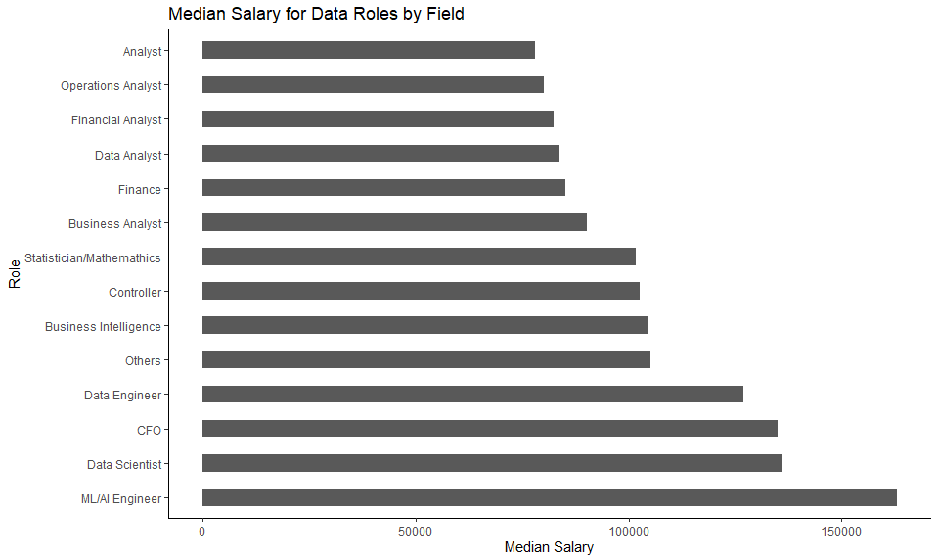
Analysts appear to make the least compared to other data jobs
ML/AI Engineer roles appear to make the most

Slide 4
Now that we have an understanding of gross salary, we can look at how much data practitioners are being paid relative to their positions or experience

Slide 5
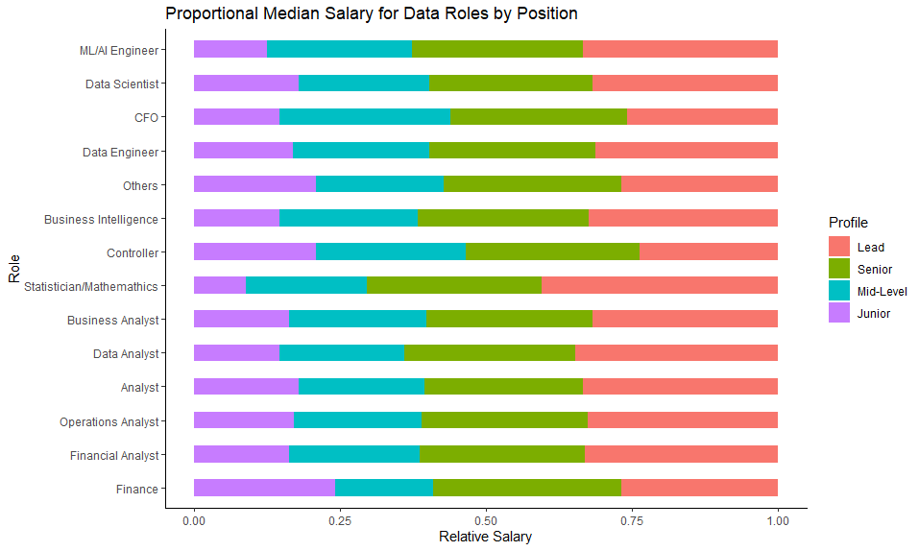
Overall, Lead & Senior roles receive the highest salary
Junior roles tend to receive the lowest, with the exception of those in Finance
Interestingly, relative salary is rather proportional within ML/AI & Data Science fields for Mid-level to Lead roles

Slide 6
What About Across States?
Now, let’s turn our attention to how salaries differ across the states

Slide 7
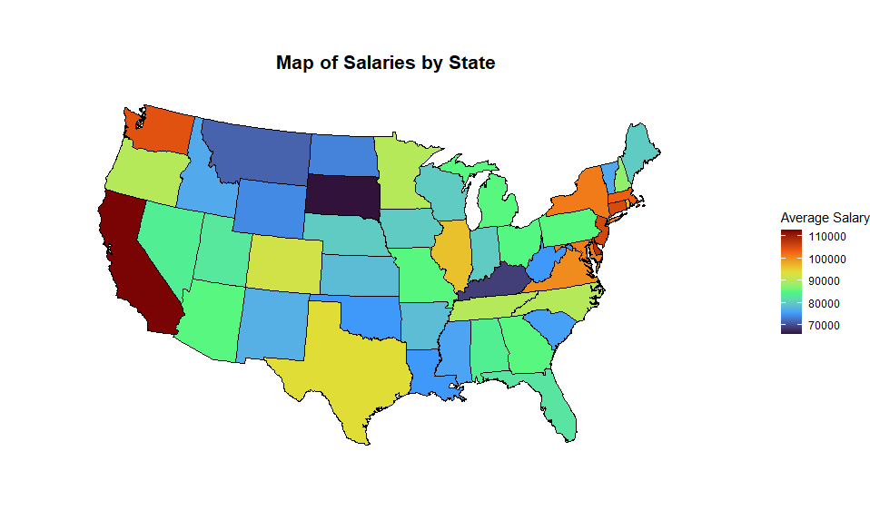
Coastal states (i.e., New York and California) appear to receive higher salaries overall
Midwest States receive lower salaries

Slide 8
But Which Roles Get Paid the Most Across States?
Finally, let’s take a look at the data practitioner roles that have the highest average salary by state

Slide 9
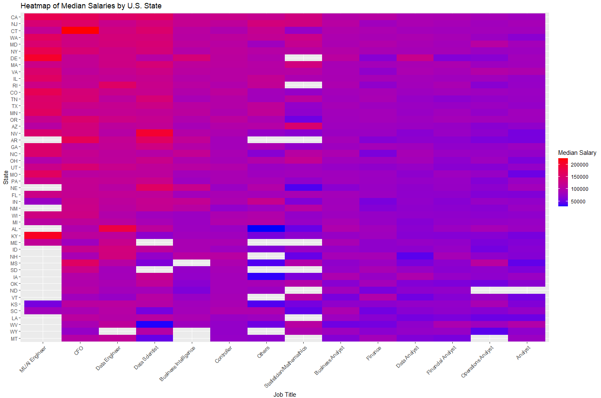
This heatmap provides a sense of which states pay the most, on average, for data practitioner roles
ML/AI Engineer roles receive the highest salaries, overall, but several states in this sample do not have public listings
Analyst salaries are rather uniform
Overall, more affluent states California, NY, and Virginia tend to provide the highest salaries

Slide 10
Conclusions
ML/AI Engineers and data scientists are offered the highest salaries
And this tends to hold true across states
Analyst positions receive the lowest salaries
This also holds true across states
There appears to be variation in salaries across states for Statistician and Other roles
Overall, midwestern and southern states tend to pay the lowest salaries, overall
Coastal states tend to pay higher salaries, overall
Likely based on local economic factors and varying demand for data roles
For instance, New York and California are considered economic and tech-hubs, so it makes sense that they would have a higher demand for data-based roles and pay higher salaries for more technical roles

